Slide 1
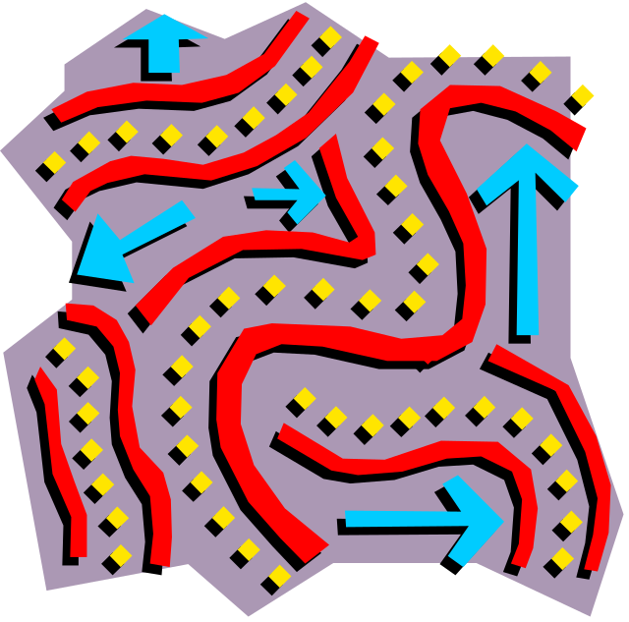
Breadth-First Search
Brute Force Approach

Slide 2

Et Tu Brute?
Brute force with duplicate checking (Breadth-First Search) opens the node with the fewest steps first.
Queue
E
A
E
B
F
D
C
A
D
B
C
F

Slide 3
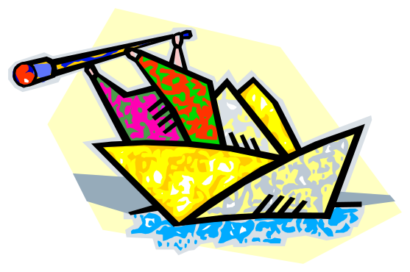
Breadth-First Search
Breadth-First Search is:
Systematic (Processes in order)
Uninformed (No prior knowledge)
Optimal in steps (Any solution found is “best”)
Complete (Will find a solution if it exists)
Exhaustive (Finds a solution if state space is finite)

Slide 4
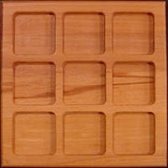








Breadth-First: The 8-Puzzle
Example:

Slide 5

Breadth-First Search of a Tree
Annabel
breadthFirst(Node *root)
{
if (!root)
return NULL;
list nodeQueue;
nodeQueue.enqueue(root);
while (!nodeQueue.empty())
{
Node* current = nodeQueue.dequeue();
if this node is the goal, return;
for each child of current:
{
nodeQueue.enqueue(child);
}
}
return NULL;
}
Betty
Cyrus
Doug
Elinore
Frank
Gary

Slide 6
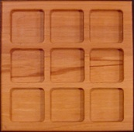











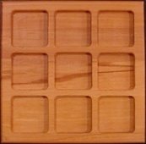










Breadth-First Search
breadthFirstSearch(SearchState start, SearchState goal)
{
queue open;
map visited;
open.enqueue(new PlannerNode(start));
visited[start] = open.front();
while (!open.empty())
{
PlannerNode* current = open.dequeue();
if current.state is the goal, we’re done;
for each valid operator at current.state:
{
SearchState successor = current.state.apply(operator);
if (visited[successor] == NULL)
{
successorNode = new PlannerNode(successor);
successorNode.parent = current;
visited[successor] = successorNode;
open.enqueue(successorNode);
}
}
}
return NULL;
}
class PlannerNode
{
SearchState state;
PlannerNode *parent;
}
Remember: we want to
trace back our path!

Slide 7

Breadth-First Search (Graph)
breadthFirstSearch(SearchNode *start, SearchNode *goal)
{
queue open;
map visited;
open.enqueue(new PlannerNode(start));
visited[start] = open.front();
while (!open.empty())
{
PlannerNode* current = open.dequeue();
if current.vertex is the goal, we’re done;
for each edge of current.vertex:
{
SearchNode *successor = edge.endpoint;
if (visited[successor] == NULL)
{
successorNode = new PlannerNode(successor);
successorNode.parent = current;
visited[successor] = successorNode;
open.enqueue(successorNode);
}
}
}
}
class PlannerNode
{
SearchNode *vertex;
PlannerNode *parent;
}

Slide 8


Some Search Optimizations
Ways we can optimize our search:
Nodes can be generated after the duplicate check
  Successor data, rather than nodes, can be duplicate-checked
  Avoids memory allocation and freeing of duplicates (lots!)
A visited nodes map can be used in place of a closed list and/or created list
  Faster access to nodes for duplicate checks
  Single data structure to search
    With the open & closed version we would have to check both containers for duplicates.
The search can be split across frames
  Eases the work load off of one frame
  Allows our AI to share CPU time with rendering
These optimizations will help us reduce memory use
and processor resource use.

Slide 9
Improving Upon Breadth-First
Problems with Breadth-First Search:
Optimal only in steps
Lots of memory
Lots of CPU time
How can we improve it?
E
5
5
4
A
B
D
2.5
C
2.5
6
6
F

